Slide 1

Mitron Bank: Analysis for New Credit Card Launch
Based on Customer Demographics
And Spendings

Slide 2
Agenda
01
Problem Statements
02
Introduction To Mitron bank
03
Objective Of the Project
04
Goal Of the Project
05
Dashboard Showcase
06
Insights
07
Recommendation
08
Benefits

Slide 3
Problem Statement
Mitron Banks wants to launch new Credit cards to Expand its Services,
But there’s Uncertainty To Address this, I, as a Data Analyst, need to Analyze a sample Dataset of 4000 Customers’ Online Spending Habits across five Cities. The Goal is to Provide insights that helps to Mitron
Banks to tailor the Credit cards to Customer needs and Market Trends

Slide 4



Introduction To Mitron bank Legacy Financial Institution
Established Reputation
Mitron Bank is a well-established financial institution with a long
history of serving customers.
Headquartered in Hyderabad
The bank's main headquarters is located in Hyderabad, a
major city in India.
Broadening Product Offerings
Mitron Bank aims to expand its
product offerings in the financial market.

Slide 5
Objective of the Project Introducing New Credit Cards
The objective is to introduce a new line of credit cards to broaden Mitron Bank's product portfolio.
The project aims to attract new customers by offering credit cards tailored to their needs.
By expanding into credit cards, Mitron Bank aims to increase its market share and compete with other financial institutions.

Slide 6

Goal Of the Project
My Goal is To Analyse the Sample Data, create
Impactful Metrics And Visuals, And Developed
A User-Friendly Dashboard For Mitron bank’s
Leaderships.
The Goal is to Deliverd Data-Driven Recommen-
dations to Mr. Bashnir Rover, Supporting to
Successful Launch Of the New Credit Card Line.

Slide 7
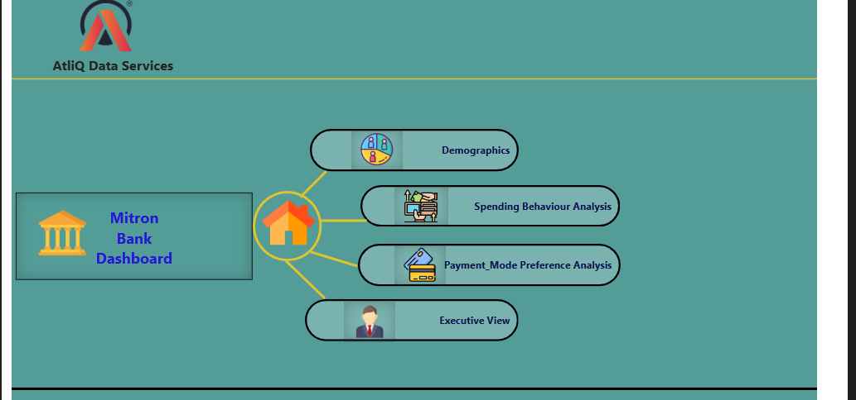
Dashboard Showcase
Home Page

Slide 8
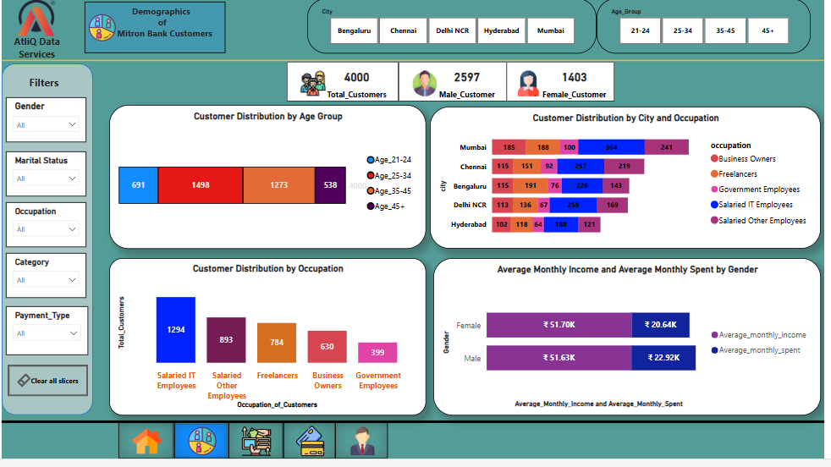
Demographic Analysis

Slide 9
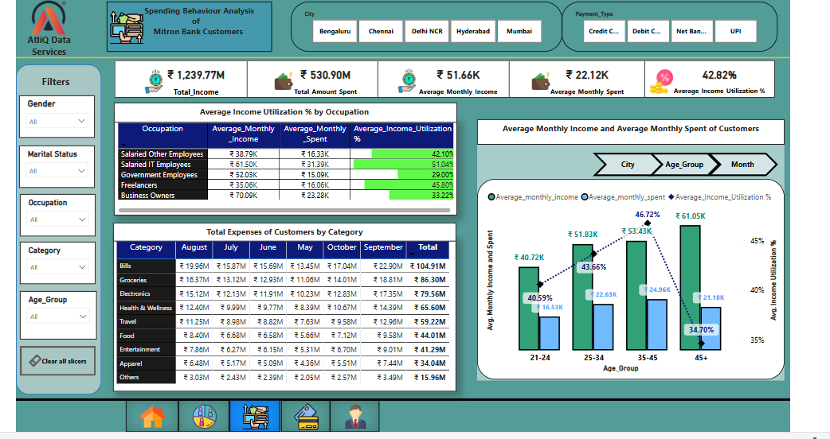
Spending Behaviour Analysis

Slide 10
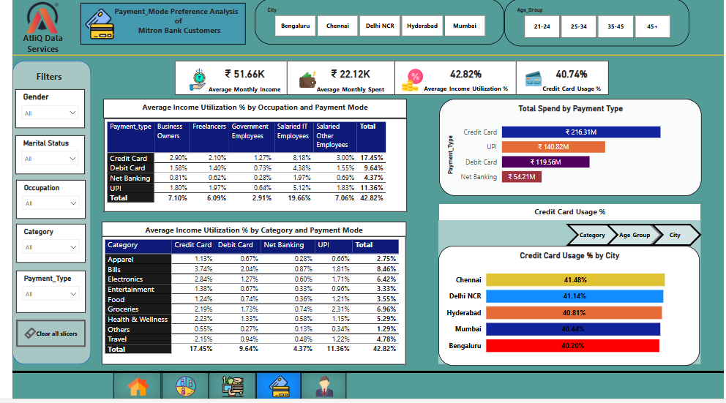
Payment_Mode preference Analysis

Slide 11
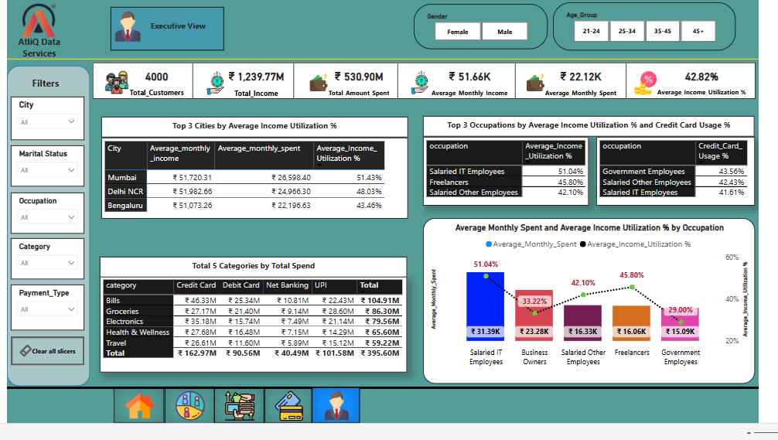
Executive view

Slide 12
Top Spending Areas
Whether It’s Settlings a Bills, getting Groceries, buying Electronics or taking care of Health and Wellness, these are the big Spenders.
Mumbai is the go-to City for spending across different Ages – It’s the Spending Champ!
Insights
Age and Spending Style
Folks Between 25-34 and 21-24 are up for a good time. Spending more on fun stuff like entertainment, Clothes and Travels.
Those over 45 are a bit more frugal, Especially when it comes to swiping that credit card.

Slide 13
Jobs And Money Talks
People with Regular IT Jobs, Business owners, And others with a Monthly Pay check Are the Big Earners And Spenders.
Freelancers And Government Employees are also not shy when its comes to opening their wallets.
Insights
Gender And Relationship Impact
Guys Are more Likely To Flash the credit Card Than the Ladies.
Married Folks Are big Spenders compared to the Singles – Love Cost.

Slide 14
City-Specific Spendings
Mumbai isn’t just a City of dreams, it’s also city of Spending, Especially With Credit cards.
Other places Like Delhi NCR, Bengaluru And Chennai have their own unique spending vibes depending on the age group.
Insights
Diving into categories
Bills, Electronics And Travel are Golden Areas for credit card Perks- Tailor Those reward For the Big Spenders!

Slide 15
Recommendations
Targeted Offers
25-34 : Diverse offers in Electronics, Entertainment And Travel.
21-24 : Youth-Centric deals in Entertainment,
Apparel & Travel.
Mumbai : Increased rewards or points on Bills,
Groceries, Electronics, and Health & Wellness.
Specialised Travel Benefits.
Salaried IT : Higher Credit Limit.
Business Owners : business-Oriented Rewards.
Males : Targeted Rewards for Electronics, Travel,
and other high values categories.
Married : Family-Centric offers like discounts on
outings, Groceries or Bills

Slide 16
Benefits
Increased Customer Satisfaction Loyalty.
Higher Credit Card usage And spend.
Stronger Brand Image and Customer Engagement.

Slide 17
THANK YOU

